Slide 1



CO₂ Emissions in the United States:
A Sectoral and Geographical Analysis

Slide 2
Content
Introduction
Project overview and objectives
Data Source and Methodology
Data collection process and API usage
Data cleaning and preprocessing steps
Exploratory Data Analysis (EDA)
Key patterns and trends identified
Visualizations and Insights
Challenges

Slide 3
Project Overview
This project analyzes CO₂ emissions in the United States from 2012 to 2022, focusing on key contributors across sectors, fuel types, and states. Using data from the U.S. Energy Information Administration (EIA) Open Data API, we explore trends and patterns to understand the distribution of emissions and identify potential areas for improvement in reducing carbon footprints.
Objective
Analyze Emission Trends by Year:
Understand how total CO₂ emissions have evolved over the past decade.
Sectoral and Fuel-Type Contributions:
Identify which sectors and fuel types are the major contributors to CO₂ emissions.
Geographical Insights:
Examine state-wise emissions to highlight regional differences and potential hotspots.
Provide Actionable Insights:
Use data-driven analysis to offer insights that could guide policy or industry strategies for reducing emissions.
Enhance Data Understanding with Visualizations:
Present key findings through clear and impactful visualizations for easy interpretation.

Slide 4

Data Source
and
Methodology
Data Source
Data from the U.S. Energy Information Administration (EIA) Open Data API (2012–2022).
Covers CO₂ emissions by state, sector, and fuel type.
Methodology
Data Collection: Fetched annual emissions data for all states.
Data Cleaning: Filtered and structured raw data.
EDA: Identified trends by year, sector, fuel type, and state.
Visualizations: Generated line plots, bar charts, and geographical maps to highlight key insights.

Slide 5
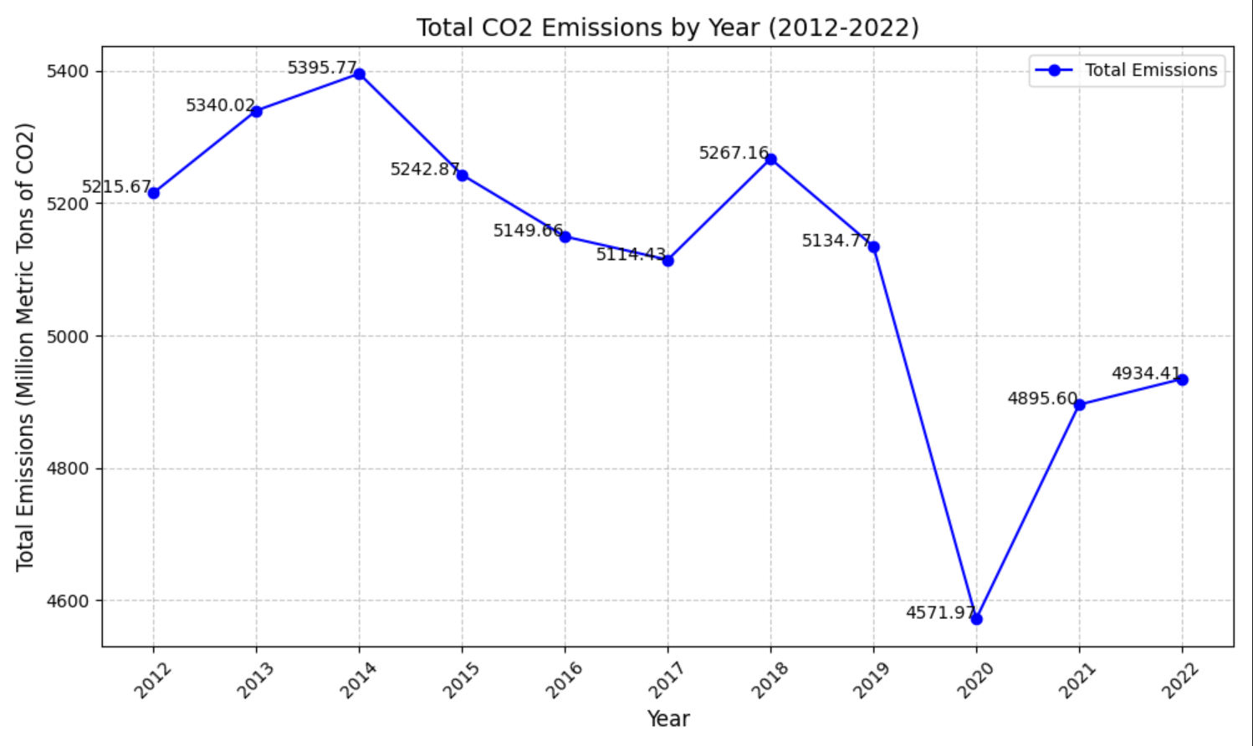
This line plot shows the total annual CO₂ emissions in the U.S. over a decade.
Insight:
The graph highlights trends in emissions, revealing whether total emissions are increasing, decreasing, or fluctuating over time.
Findings:
Emissions peaked in 2014 and dropped sharply in 2020 due to the COVID-19 pandemic.
Partial recovery occurred in 2021–2022 as activities resumed.
Causes:
2014 Peak: Economic growth.
2020 Drop: Pandemic lockdowns.
Recovery: Post-pandemic rebound.

Slide 6
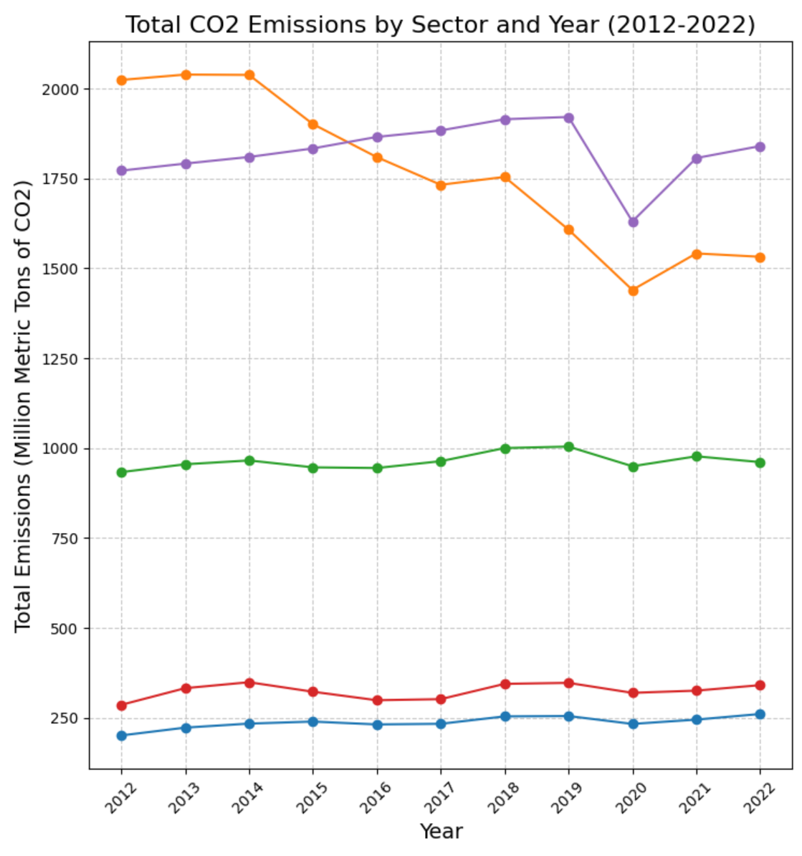
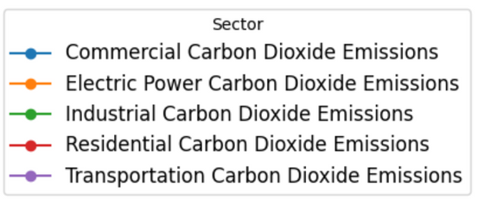
This multi-line plot compares annual CO₂ emissions across different sectors (e.g., residential, transportation, industrial).
Insight:
It identifies which sectors contribute the most to emissions and how their emissions have changed over the years.
Findings:
Transportation leads, followed by electric power.
Electric power emissions declined significantly (2012–2020).
Other sectors remained relatively stable.
2020 dip due to COVID-19.
Causes:
Electric power decline: Shift to renewables.
Transportation stability: Continued fossil fuel use.
2020 drop: Pandemic lockdowns.

Slide 7
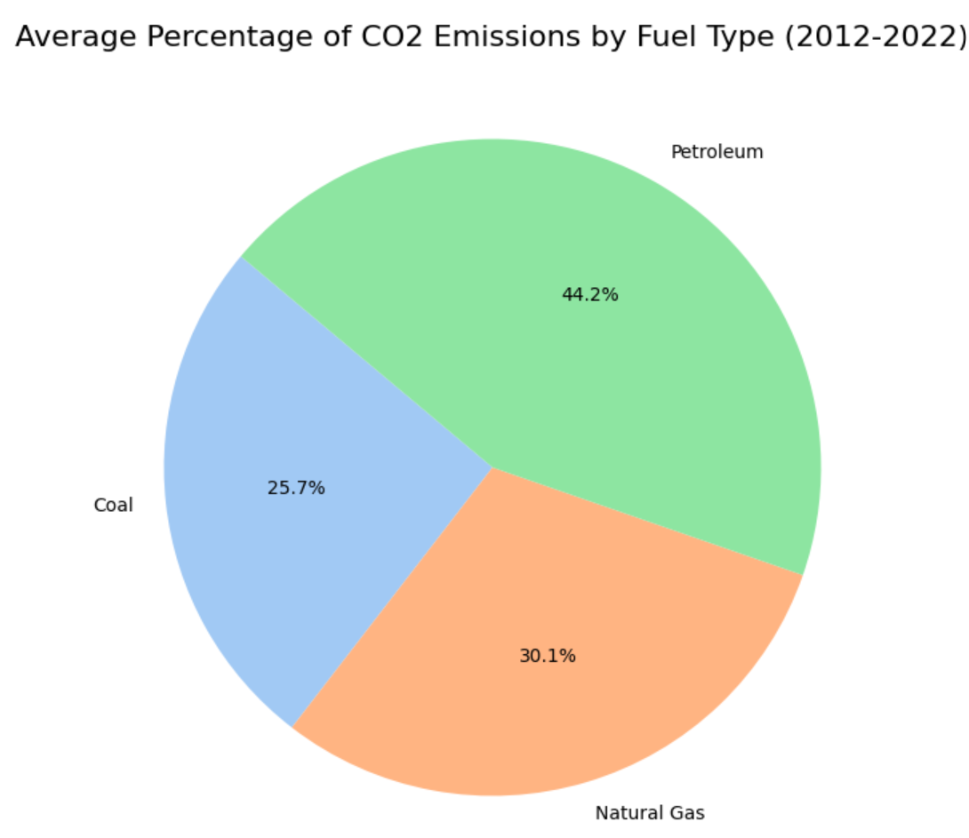
This pie chart shows the average contribution of each fuel type (e.g., coal, natural gas, petroleum) to total emissions over the decade.
Insight:
It highlights the dominant fuel types driving emissions and provides a clear breakdown of their relative impact.
Findings:
Petroleum dominates CO₂ emissions, contributing 44.2% on average.
Natural gas accounts for 30.1%, while coal contributes 25.7%.
Causes:
Petroleum's high share: Widespread use in transportation.
Natural gas growth: Increased adoption for electricity generation due to its lower carbon intensity.
Coal decline: Shift toward renewable energy and stricter emissions regulations.

Slide 8
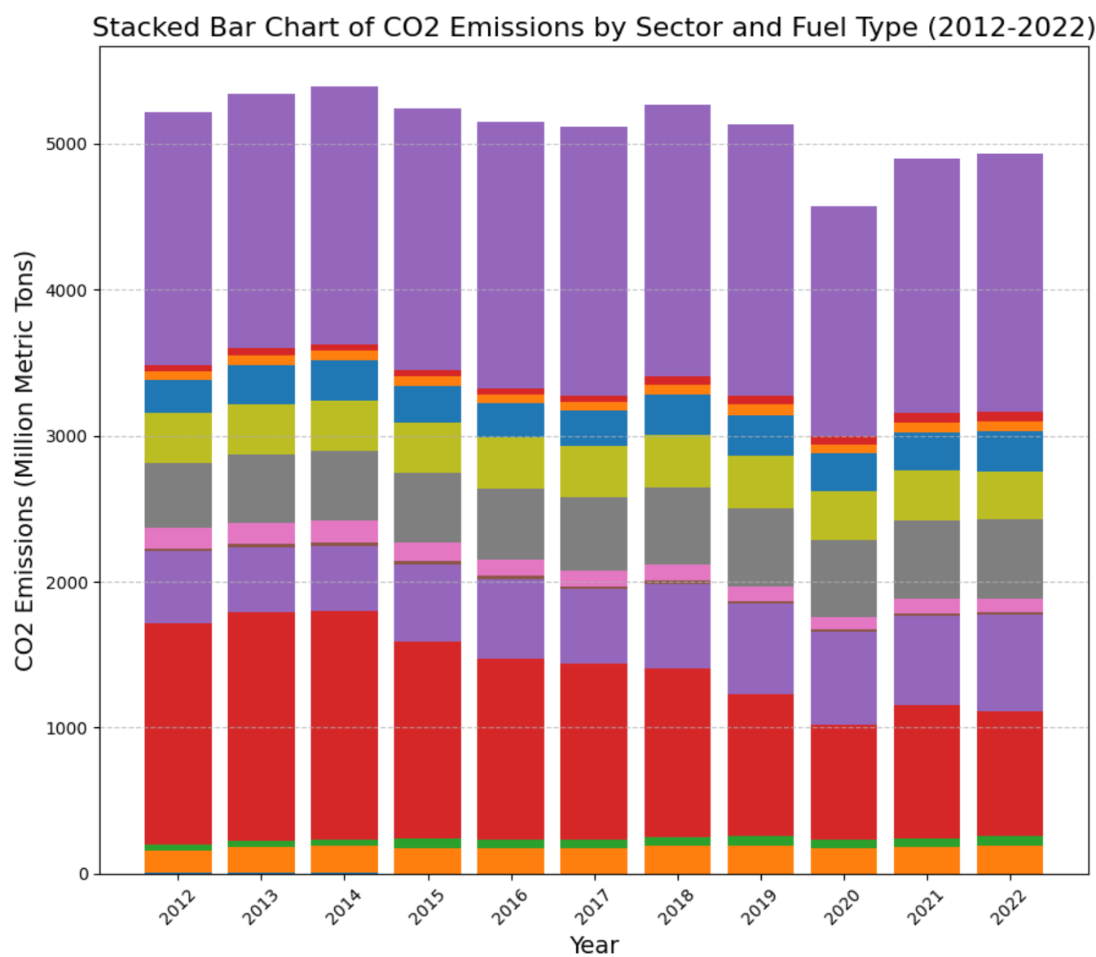
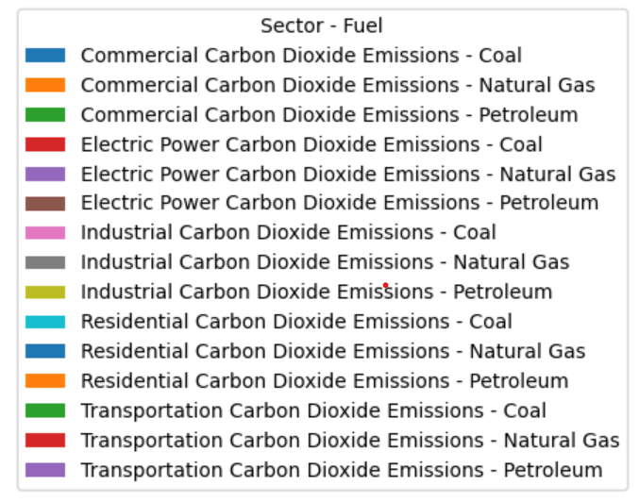
This chart breaks down annual emissions by sector and fuel type, showing the combined and individual contributions of each.
Findings:
Transportation and Electric Power dominate emissions.
Coal mostly from Electric Power, other sectors use diverse fuels.
2020 dip across sectors.
Causes:
Petroleum fuels transportation.
Natural gas replaces coal in Electric Power.
COVID-19 reduces emissions in 2020.

Slide 9
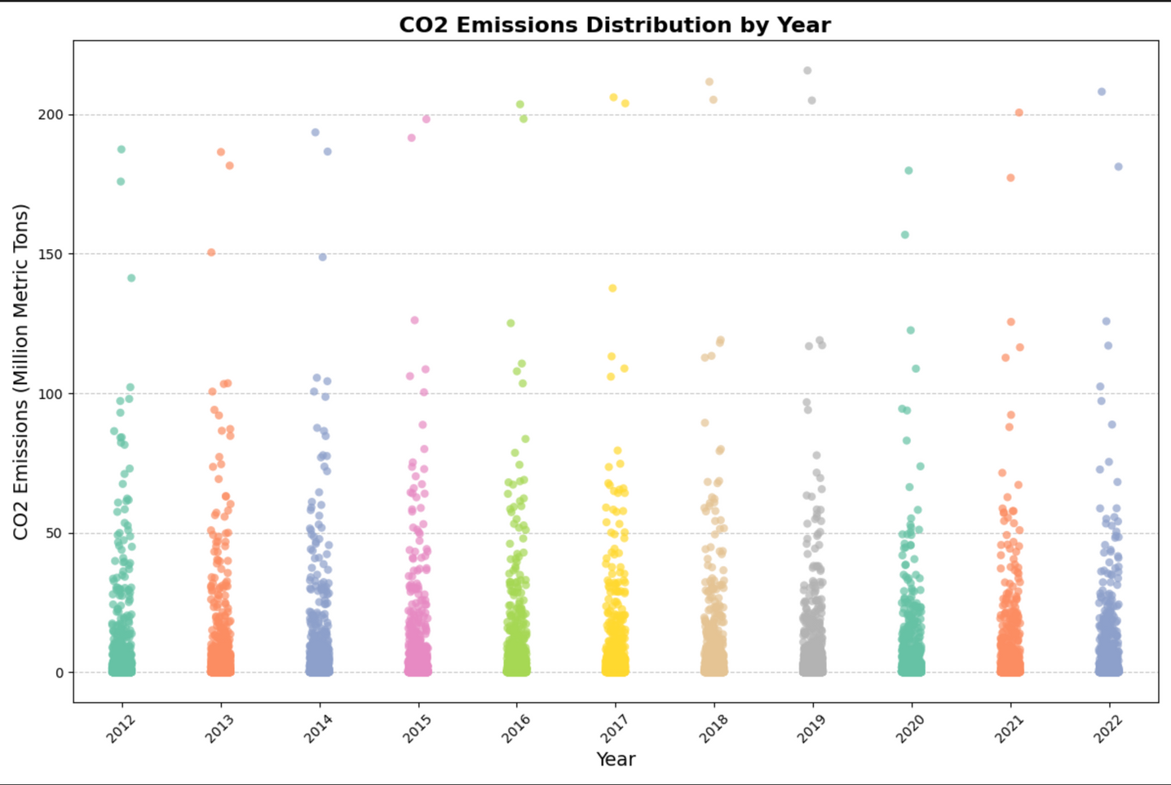
This strip plot shows the distribution of emissions across all states for each year.
Insight:
It reveals variability and potential outliers, indicating states with consistently high or low emissions.
Findings:
Wide variation in emissions between states for each year.
Outliers: Some states consistently have much higher emissions.
2020 dip: Emissions decreased across most states during the pandemic.
Causes:
High outliers: Likely due to states with large industrial or transportation activities.
2020 decrease: Reduced activity from COVID-19 lockdowns.

Slide 10
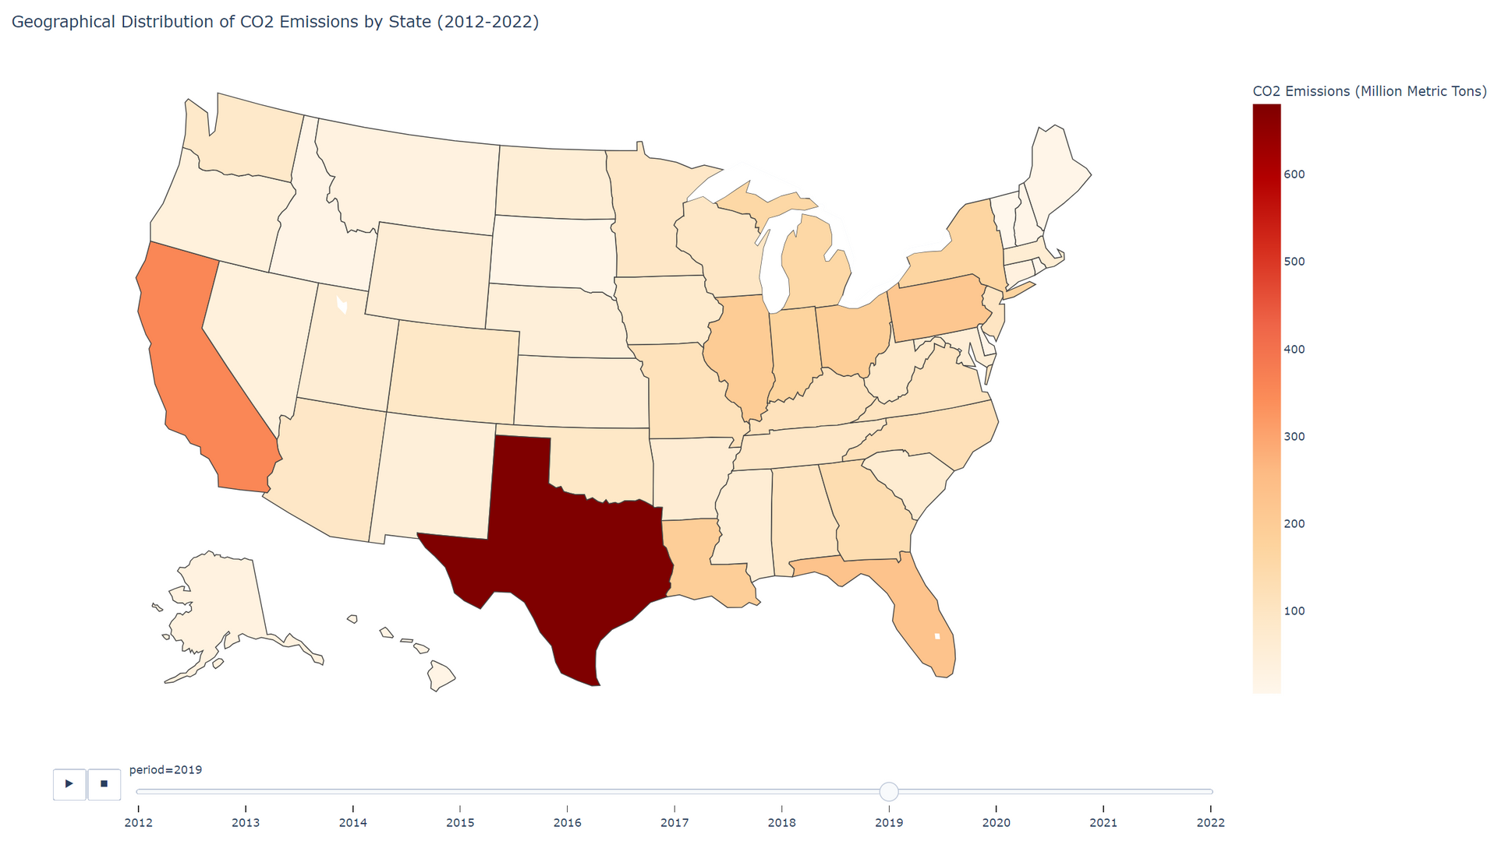
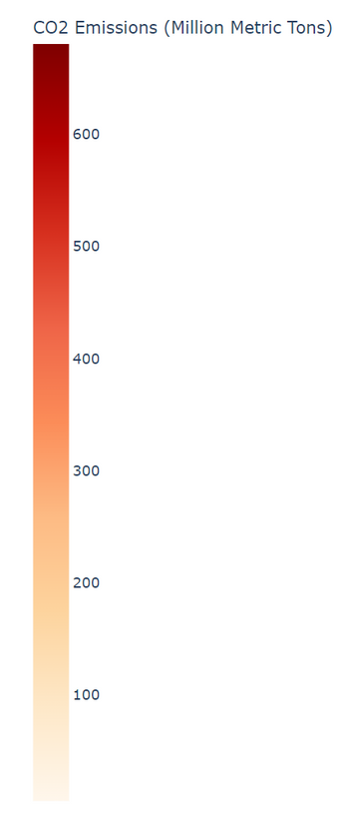
This animated choropleth map displays the total emissions for each state over time.
Insight:
It highlights regional differences and emission hotspots, providing a clear geographical perspective on CO₂ emissions.
Findings:
Texas leads in emissions, followed by California and other industrial states.
States in the Midwest and Southeast show moderate emissions, while the Northeast and Northwest have lower levels.
Emissions declined across most states in 2020, with recovery in subsequent years.
Causes:
Texas dominance: High emissions due to significant industrial and energy production activities.
Regional variations: Industrial activity, population size, and energy sources differ by state.
2020 drop: Reduced activity during COVID-19 lockdowns, followed by recovery.

Slide 11
Challenges
Data Collection and Integration
Fetching large datasets from the EIA Open Data API required handling API limitations, such as rate limits and incomplete data in some queries.
Ensuring proper integration and structure of data across different sectors, fuel types, and states.
01.
Visualization Complexity
Creating clear and meaningful visualizations to effectively convey trends across multiple dimensions (e.g., sector, fuel type, geography).
Ensuring consistent color scales and labels in visualizations for clarity and readability.
02.
03.
Technical Limitations
Managing performance issues when working with large datasets and generating high-resolution visualizations.
Ensuring compatibility across different software environments and dependencies.

Slide 12
Reference
U.S. Energy Information Administration (EIA) Open Data API
Source of CO₂ emissions data (2012–2022).
https://www.eia.gov/opendata/
Matplotlib Documentation
For creating static visualizations.
https://matplotlib.org/
Seaborn Documentation
For enhanced visualizations (e.g., strip plots).
https://seaborn.pydata.org/
Plotly Documentation
For interactive and animated visualizations (e.g., geographical map).
https://plotly.com/
Pandas Documentation
For data manipulation and preprocessing.
https://pandas.pydata.org/
Python Official Documentation
General-purpose programming for data analysis.
https://www.python.org/

Slide 13

Presented by Sandra Haro
Thank you very much!
www.reallygreatsite.com

